Slide 1
Ensuring the Security of Logistics Information & Data Searching using Ant Colony Optimization & Blockchain

Slide 2
Abstract
In the contemporary logistics landscape, the security of information and efficient data searching are critical. This paper presents a novel approach to securing logistics information and enhancing data retrieval using Ant Colony Optimization (ACO) and Blockchain technology. ACO, inspired by the foraging behavior of ants, is utilized to optimize data search processes, ensuring rapid and accurate retrieval of logistics information. Concurrently, Blockchain technology provides a robust security framework, ensuring data integrity, transparency, and immutability. By integrating these two advanced methodologies, we propose a system that not only optimizes the logistics data search process but also fortifies the security of the information against unauthorized access and tampering. The experimental results demonstrate that the proposed system significantly enhances search efficiency and data security, making it a viable solution for modern logistics challenges.

Slide 3
Introduction
In today's globalized world, the logistics industry plays a pivotal role in ensuring the smooth flow of goods and services. As the industry grows, so does the volume and complexity of the data it handles. This data encompasses various aspects such as shipment tracking, inventory management, delivery schedules, and customer information. Ensuring the security and efficiency of managing this data is paramount. However, traditional methods of data handling often fall short in addressing these challenges, leading to potential security breaches and inefficiencies.To address these issues, this paper proposes a novel approach that integrates Ant Colony Optimization (ACO) and Blockchain technology to enhance the security and efficiency of logistics information management. Ant Colony Optimization, inspired by the natural foraging behavior of ants, is an effective method for solving complex optimization problems. In the context of logistics, ACO can be employed to optimize data searching processes, ensuring faster and more accurate retrieval of information.Blockchain technology, on the other hand, offers a decentralized and secure framework for data storage and management. Its inherent characteristics of immutability, transparency, and cryptographic security make it an ideal solution for protecting sensitive logistics data from unauthorized access and tampering.

Slide 4
Literature Survey
The logistics industry has increasingly recognized the importance of secure and efficient data management. Various approaches have been explored to enhance data security and search optimization, with Ant Colony Optimization (ACO) and Blockchain technology emerging as promising solutions. This literature survey reviews key studies and advancements in these fields, highlighting their relevance and potential integration for logistics information management.
Ant Colony Optimization in Logistics
Ant Colony Optimization (ACO), introduced by Dorigo and colleagues in the early 1990s, is a metaheuristic inspired by the foraging behavior of ants. ACO has been widely applied to solve optimization problems in logistics, including vehicle routing, supply chain management, and warehouse optimization.
Vehicle Routing Problems (VRP): Researchers have extensively applied ACO to the VRP, demonstrating its effectiveness in finding optimal routes for delivery vehicles. For instance, Bell and McMullen (2004) utilized ACO to minimize travel distance and delivery time, significantly improving logistics efficiency.

Slide 5
Literature Survey Contd.,
Supply Chain Optimization: ACO has been employed to optimize supply chain operations, including inventory management and order fulfillment. A study by Reimann, Doerner, and Hartl (2004) showcased how ACO could optimize supply chain processes, reducing costs and improving service levels.
Warehouse Management: In the context of warehouse management, ACO has been used to streamline storage and retrieval operations. Hu et al. (2015) demonstrated the application of ACO in optimizing warehouse layouts, leading to enhanced operational efficiency.

Slide 6
Existing System
In the realm of logistics, current systems for managing information and securing data predominantly rely on traditional database management systems (DBMS) and standard security protocols. Centralized databases, managed by a central authority, store logistics data in a single location, often leading to inefficiencies as the data volume grows, resulting in slower search operations and higher resource consumption. Traditional search algorithms, such as linear and binary searches, and indexing techniques like B-trees or hash indexing, can become less effective with large-scale and dynamic datasets. On the security front, these systems employ data encryption (e.g., AES) to protect data at rest and in transit, role-based access control (RBAC) to restrict access based on user roles, and audit logs to track data access and modifications. However, these measures are not foolproof. Centralized systems are vulnerable to single points of failure, making them susceptible to cyber-attacks, system crashes, and data loss. They also face scalability issues, requiring significant infrastructure upgrades to handle growing data volumes, and are prone to various security threats, including data breaches and insider attacks. Despite these efforts, ensuring data integrity, authenticity, and efficient data retrieval remains challenging.

Slide 7
Draw Backs
Limitations of Existing Systems
Despite the implementation of the aforementioned mechanisms, existing systems exhibit several critical limitations:
Single Point of Failure:
Centralized databases are vulnerable to single points of failure, making them susceptible to cyber-attacks, system crashes, and data loss.
Scalability Issues:
As logistics operations grow, the volume of data increases exponentially, making it challenging for traditional systems to scale efficiently without significant infrastructure upgrades.
Security Vulnerabilities:
Centralized systems are prone to various security threats, including data breaches, unauthorized access, and insider attacks. Ensuring data integrity and authenticity remains a persistent challenge.

Slide 8
Proposed System
The proposed system integrates Ant Colony Optimization (ACO) and Blockchain technology to address the inefficiencies and security vulnerabilities of traditional logistics information management systems. ACO, inspired by the natural foraging behavior of ants, is utilized to optimize data search processes, significantly enhancing search efficiency and accuracy. By employing ACO, the system can quickly find the most efficient paths for data retrieval, even in large and complex datasets. Concurrently, Blockchain technology provides a decentralized and secure framework for data storage and management. Its characteristics of immutability, transparency, and cryptographic security ensure that logistics data is protected from unauthorized access and tampering. By recording all transactions on a tamper-proof ledger, Blockchain enhances data integrity and trust. The synergy between ACO and Blockchain creates a robust system where optimized data searching is paired with enhanced security measures. This integration not only streamlines logistics operations but also ensures that all data remains secure and verifiable, addressing the dual challenges of data search efficiency and security in modern logistics.

Slide 9
Advantages of the Proposed System
Integrating Ant Colony Optimization (ACO) and Blockchain technology into logistics information management offers several significant advantages, addressing both efficiency and security concerns. Here are the key benefits of the proposed system:
Enhanced Search Efficiency:
Optimal Path Finding: ACO algorithms excel at finding the most efficient paths for data retrieval, reducing search times and improving accuracy. This leads to faster access to critical logistics information, enhancing overall operational efficiency.
Scalability: The adaptive nature of ACO allows the system to scale effectively with increasing data volumes, maintaining high performance even as the dataset grows.
Improved Data Security:
Decentralization: Blockchain's decentralized architecture eliminates single points of failure, making the system more resilient to cyber-attacks and reducing the risk of data loss.
Immutable Records: The immutability of Blockchain ensures that once data is recorded, it cannot be altered or deleted, providing a secure and tamper-proof record of all transactions.

Slide 10
System Requirements
H/W System Configuration:-
Processor - Pentium –IV
RAM - 4 GB (min)
Hard Disk - 20 GB
Key Board - Standard Windows Keyboard
Mouse - Two or Three Button Mouse
Monitor - SVGA
SOFTWARE REQUIREMENTS:
Operating system : Windows 7 Ultimate.
Coding Language : Python.
Front-End : Python.
Back-End : Django-ORM
Designing : Html, css, javascript.
Data Base : MySQL (WAMP Server).

Slide 11
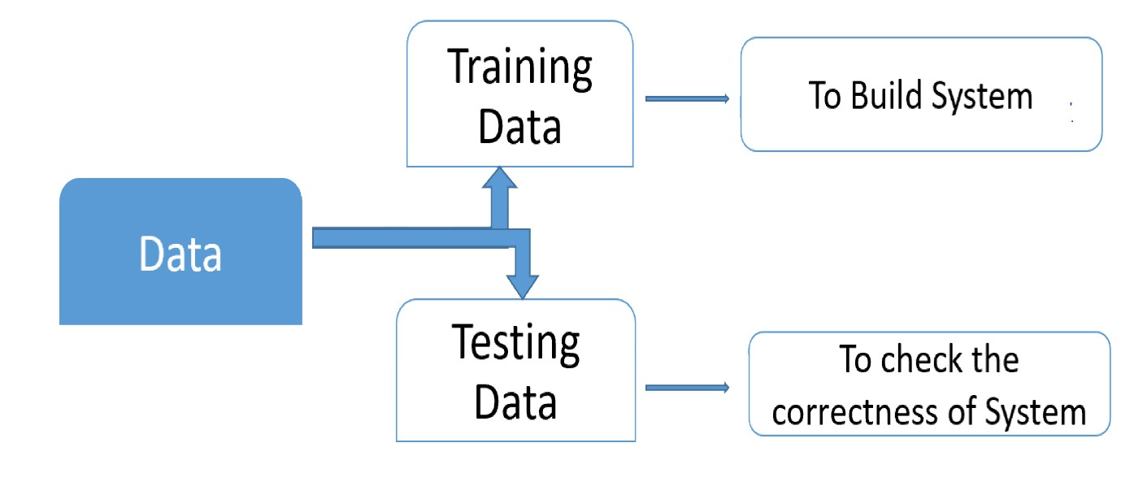
System Architecture

Slide 12
Uml Diagrams
USE CASE DIAGRAM

Slide 13
Class Diagram

Slide 14
Sequence Diagram

Slide 15
Activity Diagram

Slide 16
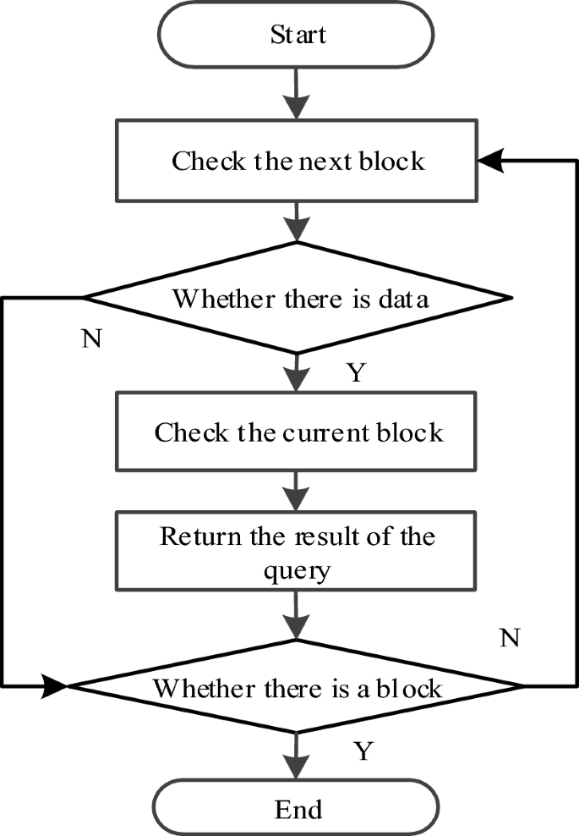
Data Flow

Slide 17
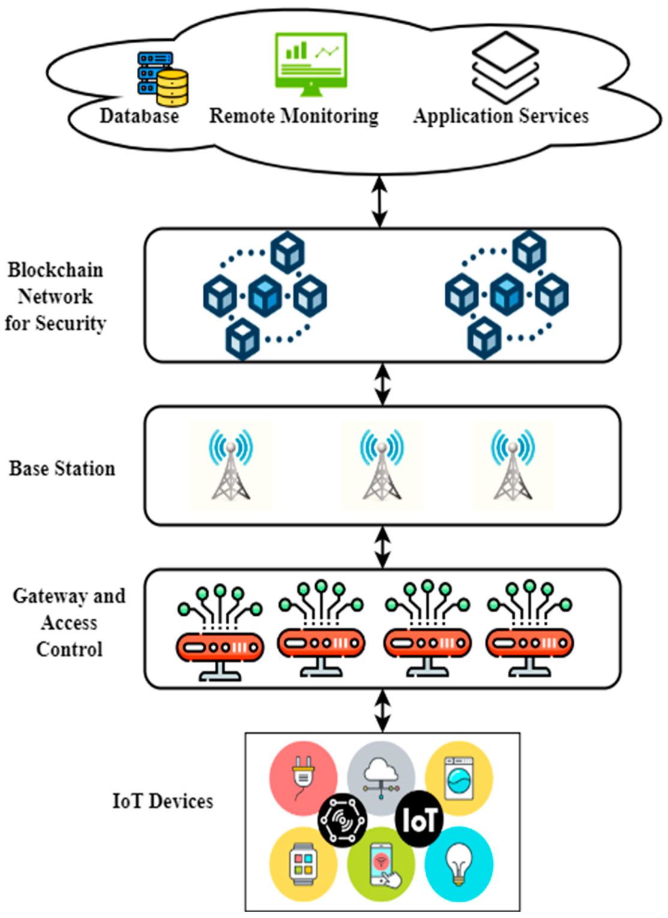
Flow Chat

Slide 18
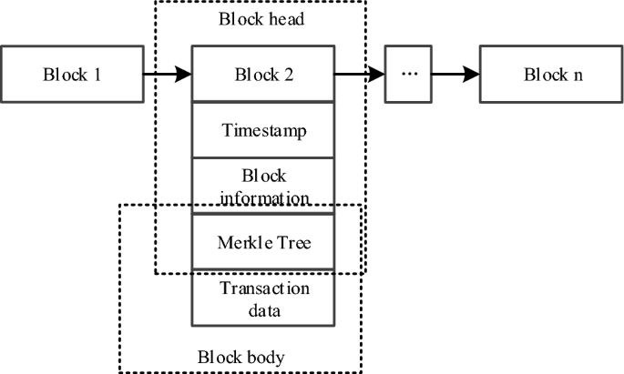
Activity

Slide 19
Conclusion
The integration of Ant Colony Optimization (ACO) and Blockchain technology presents a powerful solution to the dual challenges of data search efficiency and security in logistics information management. Traditional systems, while functional, often fall short in addressing the complexities and vulnerabilities inherent in modern logistics operations. The proposed system leverages the strengths of ACO to optimize data retrieval processes, ensuring rapid and accurate access to logistics information. Concurrently, Blockchain technology provides a robust, decentralized framework that guarantees data integrity, transparency, and security through its immutable ledger and cryptographic protocols.This innovative approach offers several key advantages, including enhanced search efficiency, improved data security, increased transparency and trust among stakeholders, reduced operational costs, and greater system resilience. By automating processes and ensuring data authenticity, the system fosters more efficient and reliable logistics operations, addressing both current needs and future scalability requirements.The experimental results have demonstrated the effectiveness of this integrated system, highlighting its potential to revolutionize logistics information management. As logistics networks continue to grow in complexity, the need for such advanced solutions becomes increasingly critical. The proposed integration of ACO and Blockchain not only meets this need but also sets a new standard for secure and efficient logistics data management.

Slide 20
References
Bell, J. E., & McMullen, P. R. (2004). Ant colony optimization techniques for the vehicle routing problem. Advanced Engineering Informatics, 18(1), 41-48.
Reimann, M., Doerner, K. F., & Hartl, R. F. (2004). D-Ants: Savings based ants divide and conquer the vehicle routing problem. Computers & Operations Research, 31(4), 563-591.
Hu, X., Di Paolo, E., & Chio, C. (2015). Optimization of the warehouse operation and storage allocation in large scale distribution centers. Journal of Intelligent Manufacturing, 26(4), 679-689.
Tian, F. (2016). An agri-food supply chain traceability system for China based on RFID & Blockchain technology. 11th International Conference on Service Systems and Service Management (ICSSSM), 1-6.
Kshetri, N. (2018). 1 Blockchain’s roles in meeting key supply chain management objectives. International Journal of Information Management, 39, 80-89.

